Slide 1

Financial Analytics
GROUP A
Christophe Duong
Giulio Antonelli
Laura Fernández Cobo
Abhinav Gupta
Jungyup Lee

Slide 2
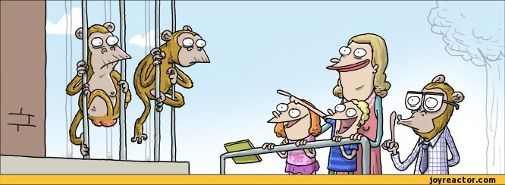
Imagine...
There is a group of monkeys in a zoo.
They are allowed to go out of the zoo once per month…

Slide 3

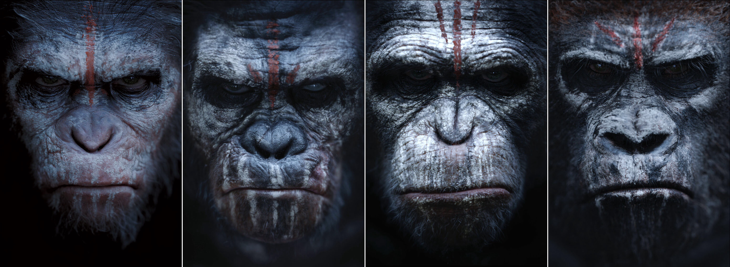

Slide 4
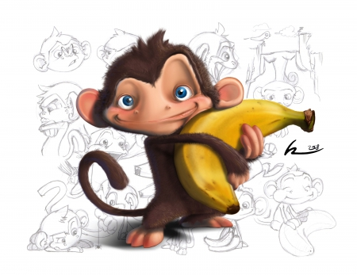
GOAL!
Looking at characteristics
of these fraud monkeys
PREDICT
Who can be allowed to go out of the zoo
?

Slide 5
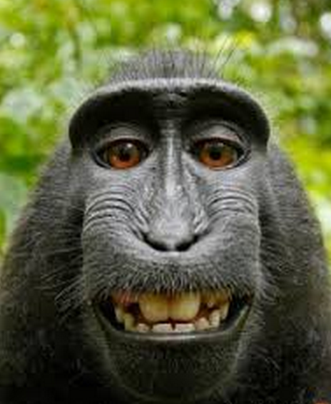
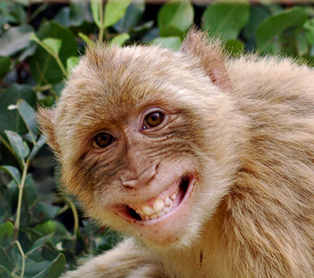
Pre-Processing…
Study data changes
Population Stability Index:
1
MODEL
Development
Out of Time
4 YEARS
Age
Height
Height
Age
Weight
0,55m
0,65m
1,02m
0,45m
…
0,80m
17²³⁄₃₂in
Weight
Type
29¹⁷⁄₃₂in
Type
Aggressive
Color
41¹¹⁄₃₂in
Aggressive
Color
Level of obedience
44³⁄₃₂in
Level of obedience
…
Gender
39³⁄₈in
Gender
PSI

Slide 6
Pre-Processing…
Study dependency
Correlation
2
20 years
6 months
Age
Height
Height
Age
Weight
0,55m
0,65m
1,02m
0,45m
0,55m
0,14m
0,21m
0,30m
0,09m
0,12m
Weight
Type
Type
Aggressive
HIGH
CORRELATION
Aggressive
Color
Color
Level of obedience
Level of obedience
Gender
Gender
VARIABLES (X1,X2,...)
VARIABLES (X1,X2,...)

Slide 7
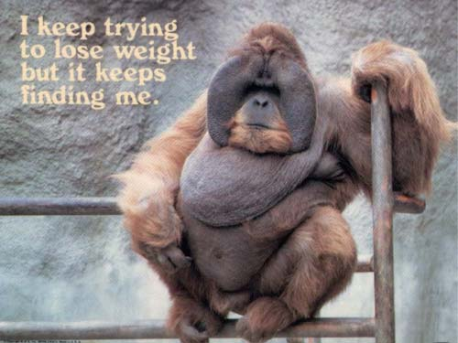
Pre-Processing…
Dimension Reduction
3
HEITH
WEIGHT
BODY SIZE
Combine variables which are expressing and providing similar value to the model and to the predictions
Notes:
PCA from the same dataset you should combine variables which are expressing and providing similar value to the model and to the predictions. (reduction of number of variables and both of the variables on PCA should give the same value and inference to the Y).

Slide 8

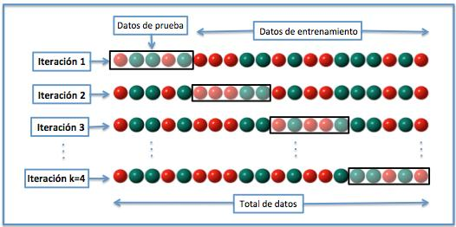

K-Fold Cross Validation Evaluation
DEVELOPMENT DATA
Development
OUT OF TIME DATA
Test Set
Training Set
Test Set
Test Set
Test Set
Notes:
Q: What is it?

Slide 9
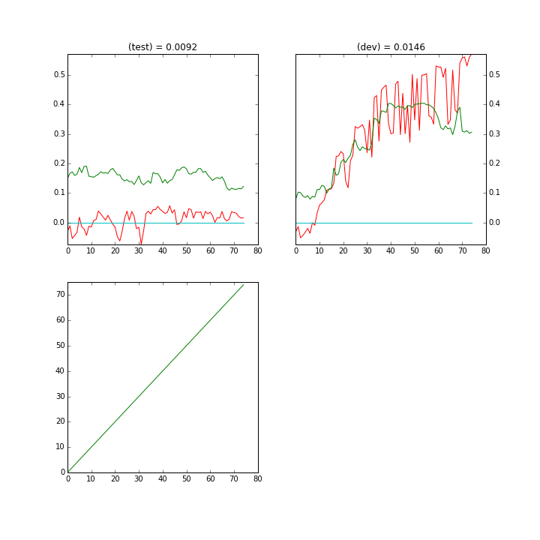
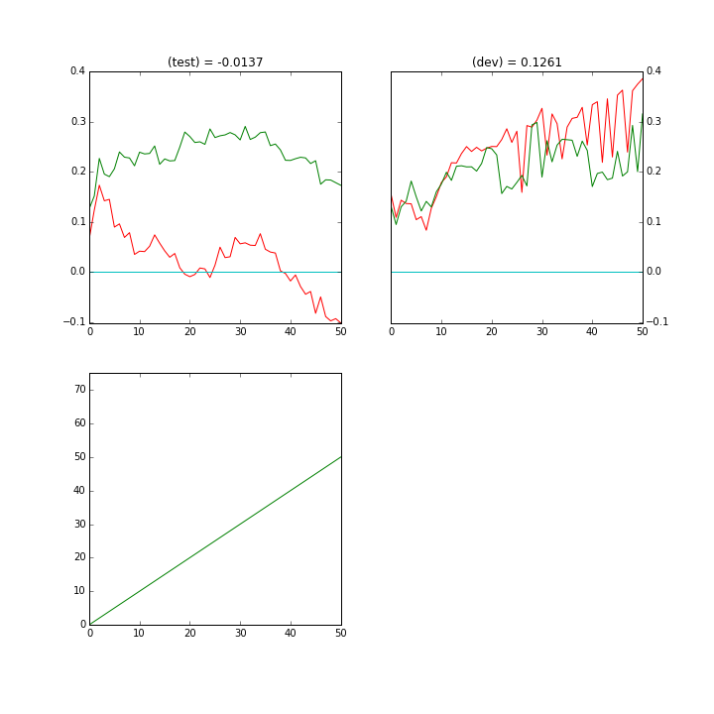
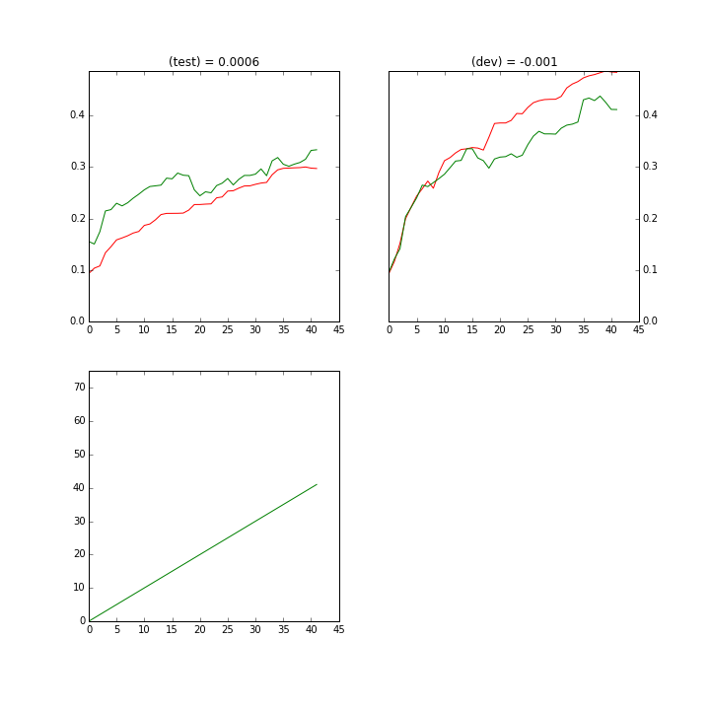
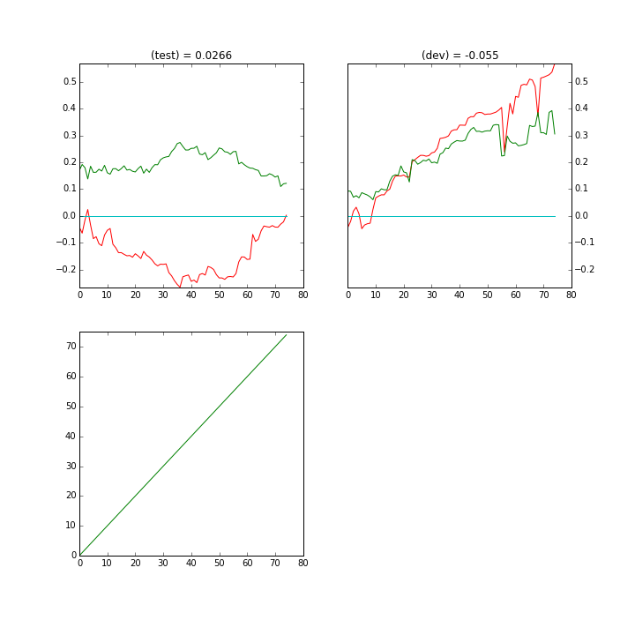
Forward approach
OOT = 0.1004
OOT = 0.1229
RANDOM
MAX IV
OOT = 0.1458
OOT = 0.2152
OOT = 0.1763
MAX GIN/KS
ERRATIC
Notes:
Q2: What are the colored lines about?
Q3: Which picture detected most criminals?
random, max iv, max gini/ks then erratic

Slide 10
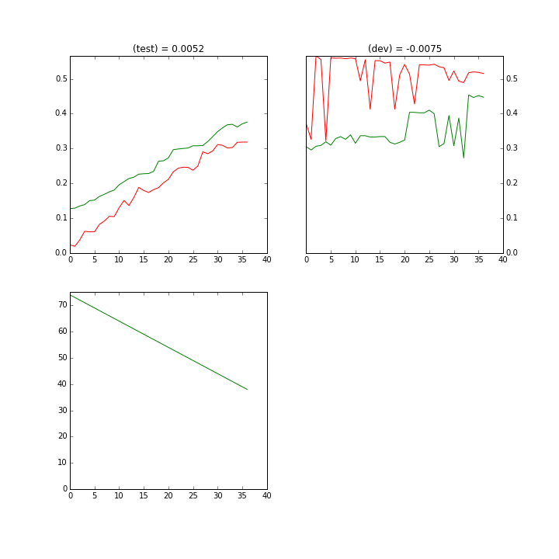
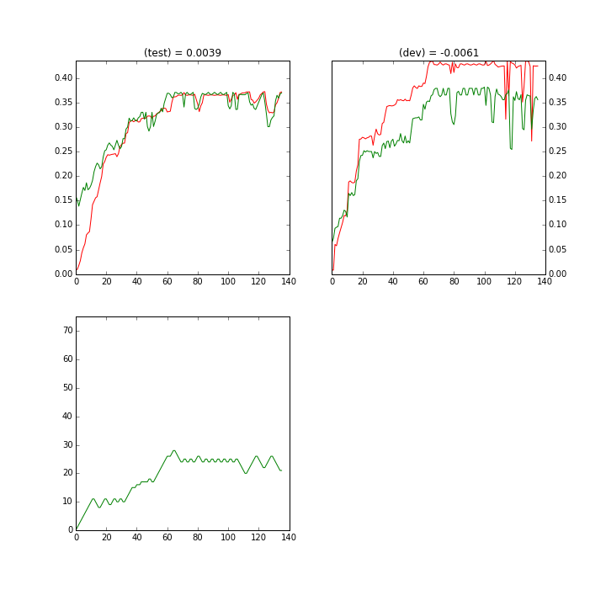
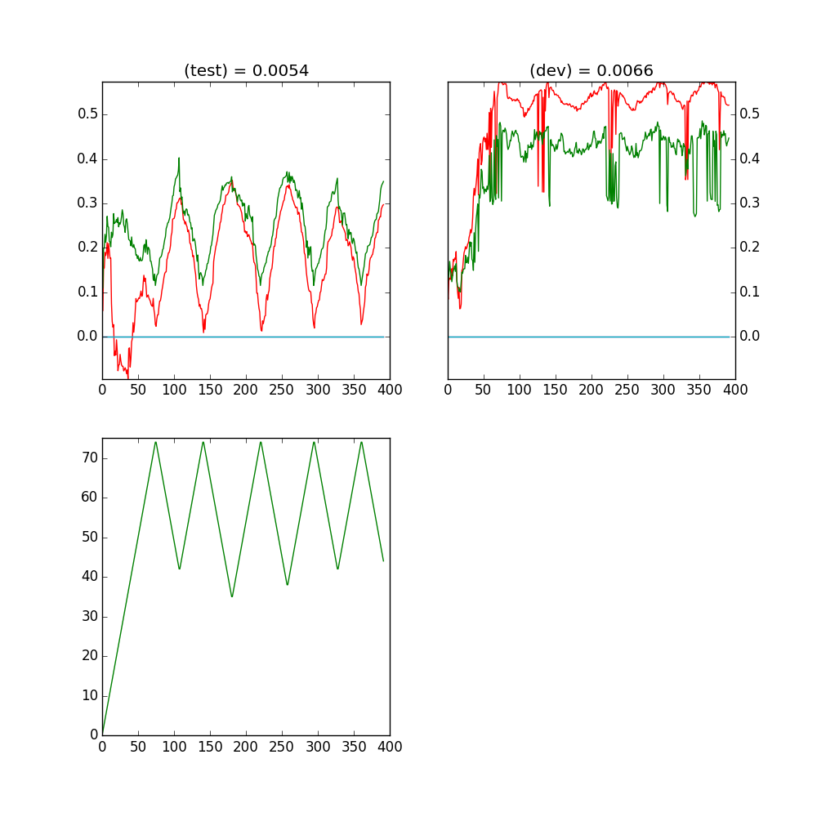
Backward & Stepwise
Backward
Stepwise
OOT = 0.1661
Notes:
Q4: Is the last picture about heart attack?

Slide 11
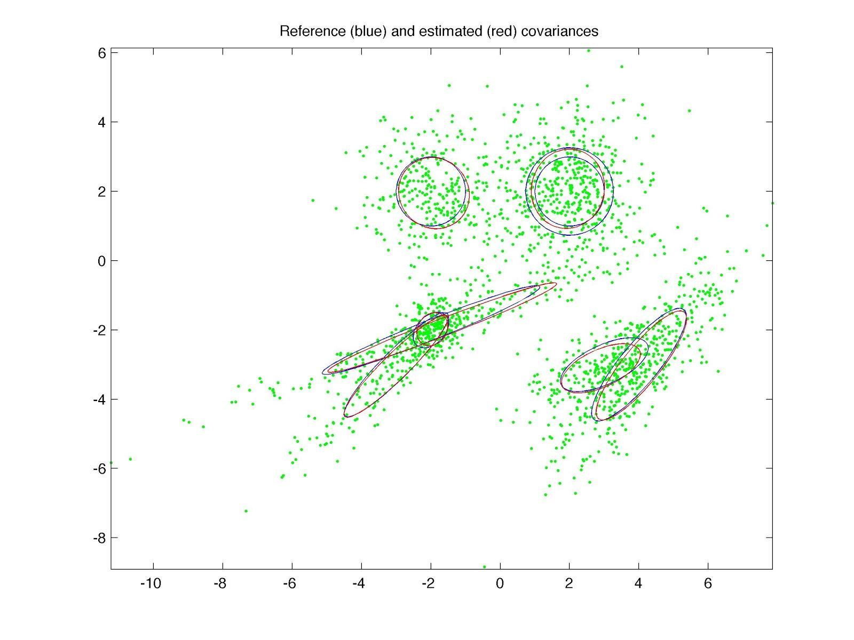
Skewed Data
Over-sampling bad vs good
Clustering: Gaussian Mixture Models bad vs good
Modify dev sample by Weight Sampling
Problems: Perfect Linear Separation Error
Notes:
Q4: is it a space picture?

Slide 12
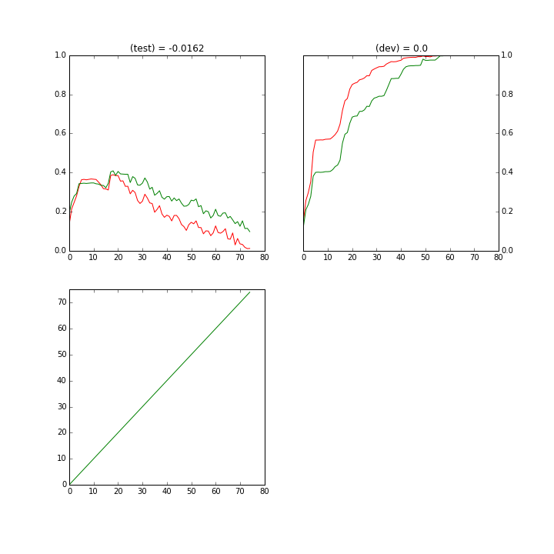
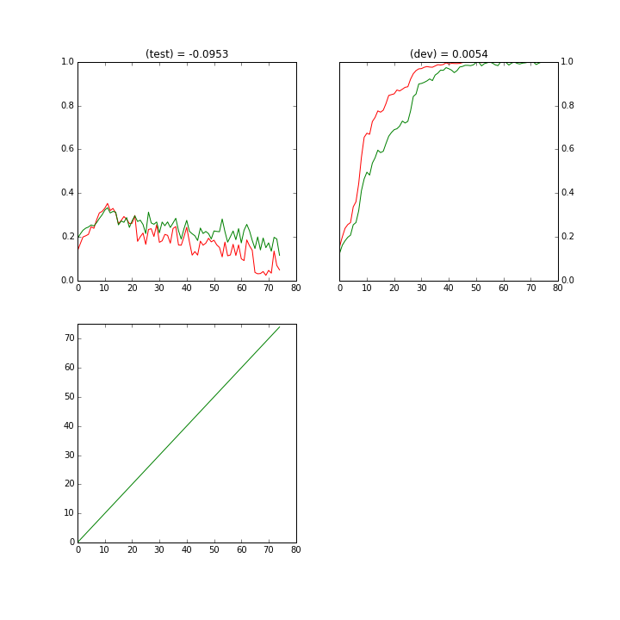

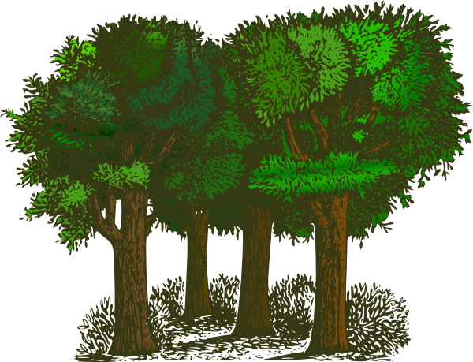
Forward Tree & Random Forest
F. TREE
R. FOREST
OOT = 0.0436
With K-folds OOT = 0.2776
OOT = 0.3023
Notes:
finish 3
Sir, Can I use your model to find bank criminals?

Slide 13
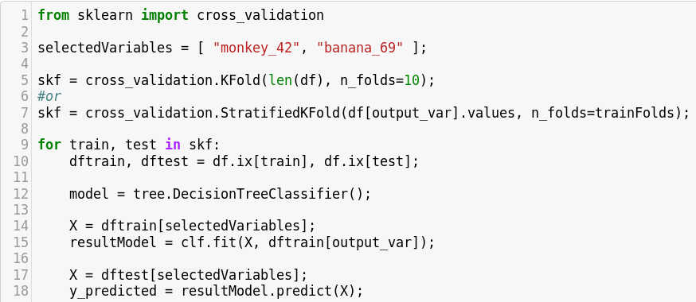
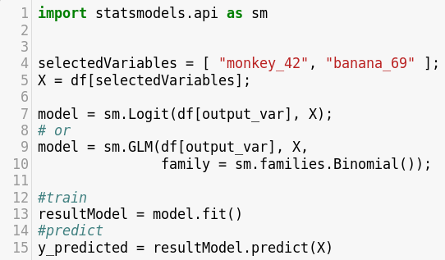
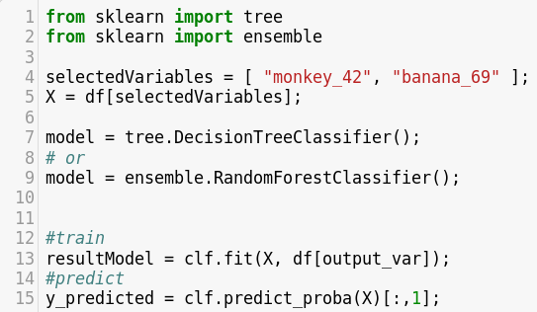
How to do it in Python?

Slide 14
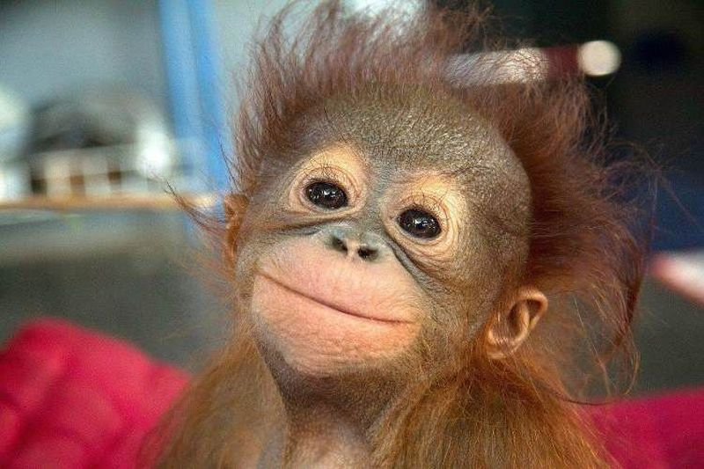
Go Plant Trees instead of Regressing Linearly into Monkeys !!

